Slide 1
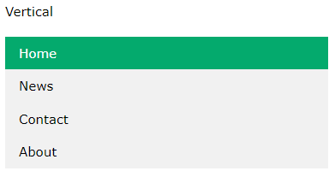
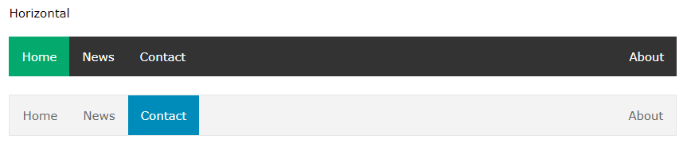
NAVIGATION BARS/ MENU BARS

Slide 2
VERTICAL NAVIGATION BARS
<!DOCTYPE html>
<html>
<body>
<ul>
<li><a href="">Home</a></li>
<li><a href="">News</a></li>
<li><a href="">Contact</a></li>
<li><a href="">About</a></li>
</ul>
</body>
</html>

Slide 3

A background color is added to the links to show the link area. whole link area is clickable, not just the text
<!DOCTYPE html>
<html>
<head>
<style>
ul {
list-style-type: none;
margin: 0;
padding: 0;
}
li a {
display: block;
width: 60px;
background-color: #dddddd;
}
</style>
</head>
<body>
<ul>
<li><a href="">Home</a></li>
<li><a href="">News</a></li>
<li><a href="">Contact</a></li>
<li><a href="">About</a></li>
</ul>
</body>
</html>

Slide 4

HORIZONTAL NAVIGATION BARS
<!DOCTYPE html>
<html>
<head>
<style>
ul {
list-style-type: none;
margin: 0;
padding: 0;
}
li {
display: inline;
}
</style>
</head>
<body>
<ul>
<li><a href="">Home</a></li>
<li><a href="">News</a></li>
<li><a href="">Contact</a></li>
<li><a href="">About</a></li>
</ul>
</body>
</html>

Slide 5
NAVIGATION BARS
ul { list-style-type: none; margin: 0; padding: 0; overflow: hidden; background-color: #333; }
li { float: left; }
li a { display: block; color: white; text-align: center; padding: 14px 16px; text-decoration: none; }
/* Change the link color to #111 (black) on hover */ li a:hover { background-color: #111; }

Slide 6
.active { background-color: #04AA6D; }

Slide 7
<ul> <li><a href="#home">Home</a></li> <li><a href="#news">News</a></li> <li><a href="#contact">Contact</a></li> <li style="float:right"><a class="active" href="#about">About</a></li> </ul>

Slide 8
li { border-right: 1px solid #bbb; } li:last-child { border-right: none; }

Slide 9
